Slide 1
Stack

Slide 2
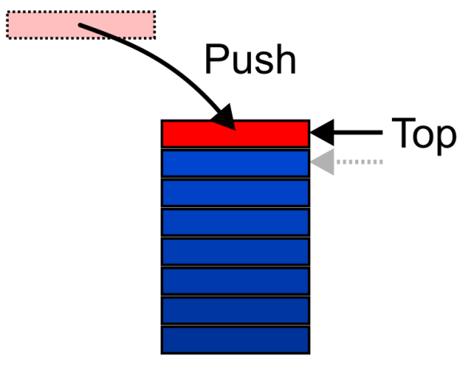
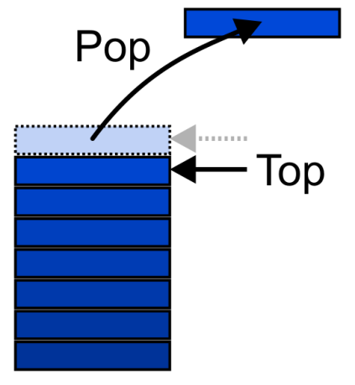
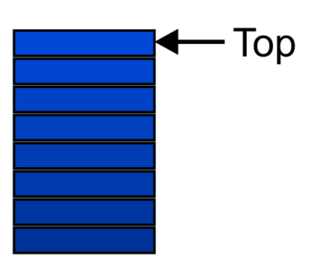
Stack
A stack is a linear data structure in which insertion and deletion of elements are done at only one end, which is known as the top of the stack. Stack is called a last-in, first-out (LIFO) structure because the last element which is added to the stack is the first element which is deleted from the stack.
Only access to the stack is the top element
consider trays in a cafeteria
to get the bottom tray out, you must first remove all of the elements above
It is an undefined operation to call either pop or top on an empty stack

Slide 3
Stack
TOP
Basic Operations of Stack
Push: the operation to place a new item at the top of the stack
Pop: the operation to remove the next item from the top of the stack
isFull: the operation to check whether the stack is full or not. It returns true if the stack is full
Isempty: the operation to check whether the stack is empty. It returns true if the stack is empty.
Algorithm for static implementation of stack
4
3
2
1
Push 5
5
4
3
2
1
TOP
5
4
3
2
1
4
3
2
1
Pop 5

Slide 4
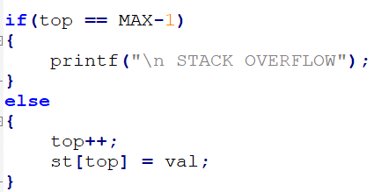
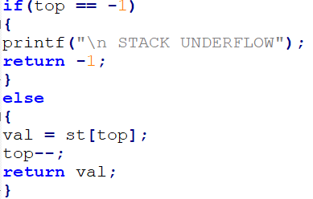
Stack
TOP
Push
Pop
Step 1: IF TOP = MAX-1
PRINT OVERFLOW
[END OF IF]
Step 2: SET TOP = TOP + 1
Step 3: SET STACK[TOP] = VALUE
Step 4: END
4
3
2
1
add 5
5
4
3
2
1
TOP
Algorithm for push operation
Sample code for push operation
push operation
Step 1: IF TOP = NULL
PRINT UNDERFLOW
[END OF IF]
Step 2: SET VAL = STACK[TOP]
Step 3: SET TOP = TOP - 1
Step 4: END
5
4
3
2
1
4
3
2
1
delete 5
Algorithm for pop operation
Sample code for pop operation
pop operation

Slide 5
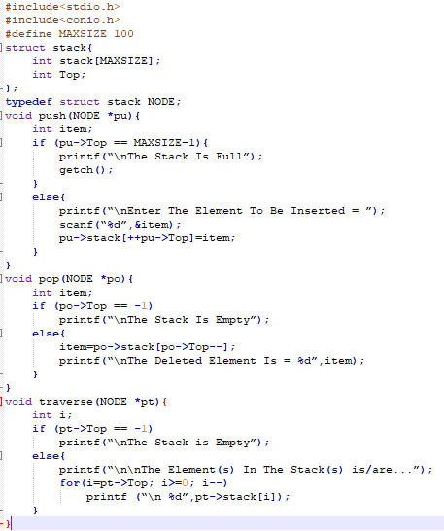
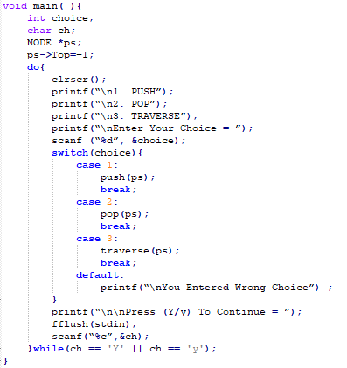
Stack
Write a menu program to show implementation of stack using C
Notes:
#include<stdio.h>
#include<conio.h>
#define MAXSIZE 100
struct stack{
int stack[MAXSIZE];
int Top;
};
typedef struct stack NODE;
void push(NODE *pu){
int item;
if (pu->Top == MAXSIZE–1){
printf(“\nThe Stack Is Full”);
getch();
}
else{
printf(“\nEnter The Element To Be Inserted = ”);
scanf(“%d”,&item);
pu->stack[++pu->Top]=item;
}
}
void pop(NODE *po){
int item;
if (po->Top == -1)
printf(“\nThe Stack Is Empty”);
else{
item=po->stack[po->Top--];
printf(“\nThe Deleted Element Is = %d”,item);
}
}
void traverse(NODE *pt){
int i;
if (pt->Top == -1)
printf(“\nThe Stack is Empty”);
else{
printf(“\n\nThe Element(s) In The Stack(s) is/are...”);
for(i=pt->Top; i>=0; i--)
printf (“\n %d”,pt->stack[i]);
}
}
void main( ){
int choice;
char ch;
NODE *ps;
ps->Top=–1;
do{
clrscr();
printf(“\n1. PUSH”);
printf(“\n2. POP”);
printf(“\n3. TRAVERSE”);
printf(“\nEnter Your Choice = ”);
scanf (“%d”, &choice);
switch(choice){
case 1:
push(ps);
break;
case 2:
pop(ps);
break;
case 3:
traverse(ps);
break;
default:
printf(“\nYou Entered Wrong Choice”) ;
}
printf(“\n\nPress (Y/y) To Continue = ”);
fflush(stdin);
scanf(“%c”,&ch);
}while(ch == 'Y' || ch == 'y');
}

Slide 6
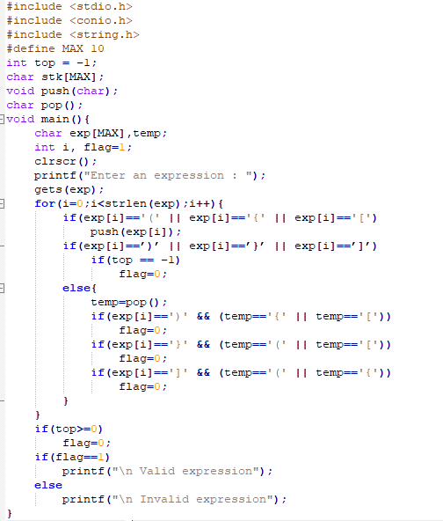
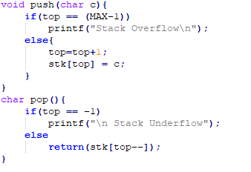
Application of Stack
Write a program to check nesting of parentheses using a stack.
Notes:
#include<stdio.h>
#include<conio.h>
#define MAXSIZE 100
struct stack{
int stack[MAXSIZE];
int Top;
};
typedef struct stack NODE;
void push(NODE *pu){
int item;
if (pu->Top == MAXSIZE–1){
printf(“\nThe Stack Is Full”);
getch();
}
else{
printf(“\nEnter The Element To Be Inserted = ”);
scanf(“%d”,&item);
pu->stack[++pu->Top]=item;
}
}
void pop(NODE *po){
int item;
if (po->Top == -1)
printf(“\nThe Stack Is Empty”);
else{
item=po->stack[po->Top--];
printf(“\nThe Deleted Element Is = %d”,item);
}
}
void traverse(NODE *pt){
int i;
if (pt->Top == -1)
printf(“\nThe Stack is Empty”);
else{
printf(“\n\nThe Element(s) In The Stack(s) is/are...”);
for(i=pt->Top; i>=0; i--)
printf (“\n %d”,pt->stack[i]);
}
}
void main( ){
int choice;
char ch;
NODE *ps;
ps->Top=–1;
do{
clrscr();
printf(“\n1. PUSH”);
printf(“\n2. POP”);
printf(“\n3. TRAVERSE”);
printf(“\nEnter Your Choice = ”);
scanf (“%d”, &choice);
switch(choice){
case 1:
push(ps);
break;
case 2:
pop(ps);
break;
case 3:
traverse(ps);
break;
default:
printf(“\nYou Entered Wrong Choice”) ;
}
printf(“\n\nPress (Y/y) To Continue = ”);
fflush(stdin);
scanf(“%c”,&ch);
}while(ch == 'Y' || ch == 'y');
}

Slide 7
Evaluation of Arithmetic Expressions
Infix Expression: operator is written between the operand A+B
Prefix Expression: operator is written before the operand +AB
Postfix Expression: operator is written after the operand AB+
Infix
Prefix
Postfix
For expression 2+3*5
+First: (2+3)*5 = 5*5 = 25
*First: 2+(3*5) = 2+15 = 17
Parenthesis needed
+ 2 * 3 5 =
* + 2 3 5 =
No parentheses needed!
2 3 5 * + =
= + 2 * 3 5
= + 2 15 = 17
= 2 3 5 * +
= 2 15 + = 17
= * + 2 3 5
= * 5 5 = 25
2 3 + 5 * =
= 2 3 + 5 *
= 5 5 * = 25
No parentheses needed!
Infix is the only notation that requires parentheses in order to change the order in which the operations are done.

Slide 8
Infix to Prefix Conversion
Move each operator to the left of its operands & remove the parentheses:
( ( A + B) * ( C + D ) )
Move each operator to the left of its operands & remove the parentheses:
( + A B * ( C + D ) )
Move each operator to the left of its operands & remove the parentheses:
* + A B ( C + D )
Move each operator to the left of its operands & remove the parentheses:
* + A B + C D
Order of operands does not change!
Notes:
Start with Fully parenthesized expression. Move each operator to the left of its operands and remove the set of parentheses.

Slide 9
Infix to Postfix
( ( ( A + B ) * C ) - ( ( D + E ) / F ) )
A B + C * D E + F / -
Operand order does not change!
Operators are in order of evaluation!

Slide 10
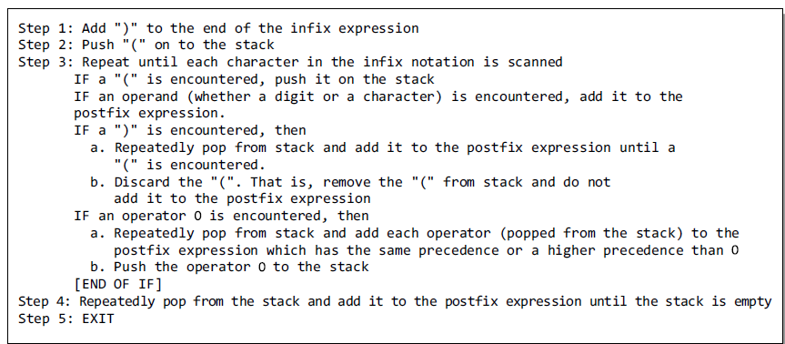
Algorithm to convert an infix notation to postfix notation

Slide 11
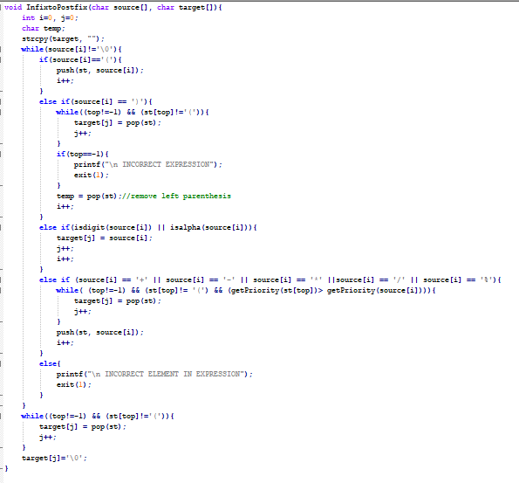
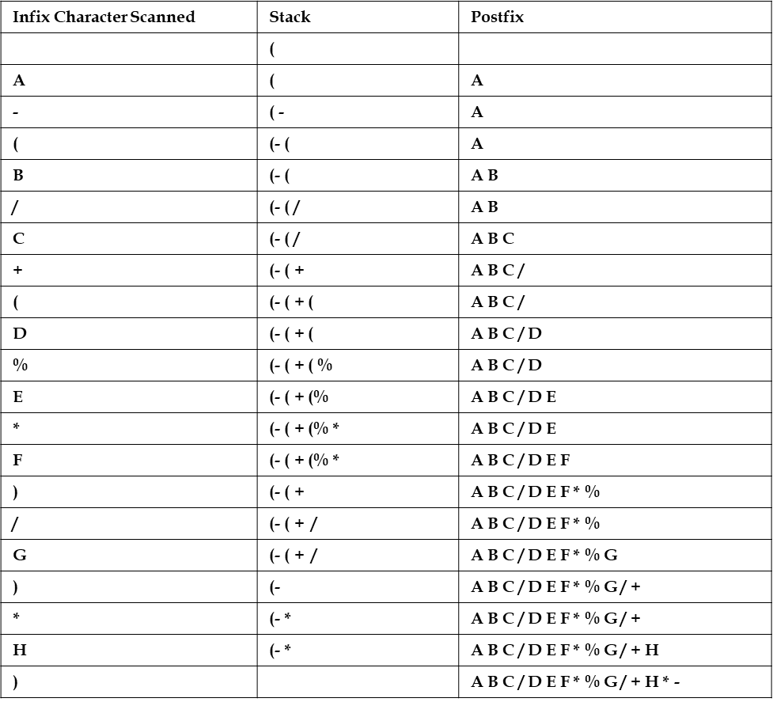
Algorithm to convert an infix notation to postfix notation
A – (B / C + (D % E * F) / G)* H

Slide 12
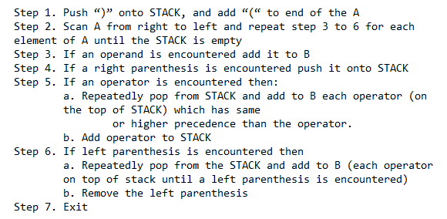
Algorithm to convert an infix notation to Prefix notation

Slide 13
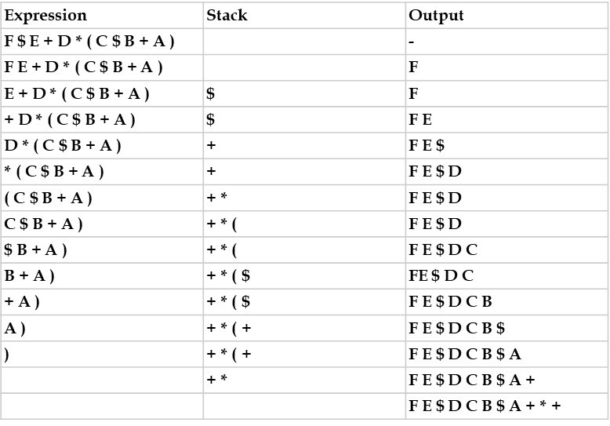
Algorithm to convert an infix notation to prefix notation
Expression = (A+B$C)*D+E$F Step 1. Reverse the infix expression. F$E+D*)C$B+A( Step 2. Make Every '(' as ')' and every ')' as '(' F$E+D*(C$B+A) Step 3. Convert expression to postfix form.
Write a string revers function
Use infix to postfix conversion program
Reverse the output F E $ D C B $ A + * + to get prefix of given infix which is + * + A $ B C D $ E F
Notes:
struct infix{
char target[MAX] ;
char stack[MAX] ;
char *s, *t ;
int top, l ;
} ;
void initinfix ( struct infix * ) ;
void setexpr ( struct infix *, char * ) ;
void push ( struct infix *, char ) ;
char pop ( struct infix * ) ;
void convert ( struct infix * ) ;
int priority ( char c ) ;
void show ( struct infix ) ;
void main( ){
struct infix q ;
char expr[MAX] ;
clrscr( ) ;
initinfix ( &q ) ;
printf ( "\nEnter an expression in infix form: " ) ;
gets ( expr ) ;
setexpr ( &q, expr ) ;
convert ( &q ) ;
printf ( "The Prefix expression is: " ) ;
show ( q ) ;
getch( ) ;
}
/* initializes elements of structure variable */
void initinfix ( struct infix *pq ){
pq -> top = -1 ;
strcpy ( pq -> target, "" ) ;
strcpy ( pq -> stack, "" ) ;
pq -> l = 0 ;
}
/* reverses the given expression */
void setexpr ( struct infix *pq, char *str ){
pq -> s = str ;
strrev ( pq -> s ) ;
pq -> l = strlen ( pq -> s ) ;
*( pq -> target + pq -> l ) = '\0' ;
pq -> t = pq -> target + ( pq -> l - 1 ) ;
}
/* adds operator to the stack */
void push ( struct infix *pq, char c ){
if ( pq -> top == MAX - 1 )
printf ( "\nStack is full.\n" ) ;
else{
pq -> top++ ;
pq -> stack[pq -> top] = c ;
}
}
/* pops an operator from the stack */
char pop ( struct infix *pq ){
if ( pq -> top == -1 ){
printf ( "Stack is empty\n" ) ;
return -1 ;
}
else{
char item = pq -> stack[pq -> top] ;
pq -> top-- ;
return item ;
}
}
/* converts the infix expr. to prefix form */
void convert ( struct infix *pq ){
char opr ;
while ( *( pq -> s ) ){
if ( *( pq -> s ) == ' ' || *( pq -> s ) == '\t' ){
pq -> s++ ;
continue ;
}
if ( isdigit ( *( pq -> s ) ) || isalpha ( *( pq -> s ) ) ){
while ( isdigit ( *( pq -> s ) ) || isalpha ( *( pq -> s ) ) ){
*( pq -> t ) = *( pq -> s ) ;
pq -> s++ ;
pq -> t-- ;
}
}
if ( *( pq -> s ) == ')' ){
push ( pq, *( pq -> s ) ) ;
pq -> s++ ;
}
if ( *( pq -> s ) == '*' || *( pq -> s ) == '+' || *( pq -> s ) == '/' || *( pq -> s ) == '%' || *( pq -> s ) == '-' || *( pq -> s ) == '$' ){
if ( pq -> top != -1 ){
opr = pop ( pq ) ;
while ( priority ( opr ) > priority ( *( pq -> s ) ) ){
*( pq -> t ) = opr ;
pq -> t-- ;
opr = pop ( pq ) ;
}
push ( pq, opr ) ;
push ( pq, *( pq -> s ) ) ;
}
else
push ( pq, *( pq -> s ) ) ;
pq -> s++ ;
}
if ( *( pq -> s ) == '(' ){
opr = pop ( pq ) ;
while ( opr != ')' ){
*( pq -> t ) = opr ;
pq -> t-- ;
opr = pop ( pq ) ;
}
pq -> s++ ;
}
}
while ( pq -> top != -1 ){
opr = pop ( pq ) ;
*( pq -> t ) = opr ;
pq -> t-- ;
}
pq -> t++ ;
}
/* returns the priority of the operator */
int priority ( char c ){
if ( c == '$' )
return 3 ;
if ( c == '*' || c == '/' || c == '%' )
return 2 ;
else{
if ( c == '+' || c == '-' )
return 1 ;
else
return 0 ;
}
}
/* displays the prefix form of given expr. */
void show ( struct infix pq ){
while ( *( pq.t ) ){
printf ( " %c", *( pq.t ) ) ;
pq.t++ ;
}
}

Slide 14
Evaluation of Expressions
Infix to Posfix
Use stack to change infix into posfix
(
a
/
(
b
-
c
+
d
)
)
*
(
e
-
a
)
*
c
\0
First, we prepare a stack and an array.
Put operators to stack and numbers to array.

Slide 15
Evaluation of Expressions
Infix to Posfix
Use stack to change infix into posfix
/
(
b
-
c
+
d
)
)
*
(
e
-
a
)
*
c
\0
a
First, we prepare a stack and an array.
Put operators to stack and numbers to array.
If the operator is high order than the top term of stack,
push it to stack, otherwise pop the top term to array.
However, the ( ) operators without following the rules,
push “(“ on any operators and pop when push “)” to stack.
(

Slide 16
Evaluation of Expressions
Infix to Posfix
Not high order than “-”
Use stack to change infix into posfix
-
c
+
d
)
)
*
(
e
-
a
)
*
c
\0
a
b
First, we prepare a stack and an array.
Put operators to stack and numbers to array.
If the operator is high order than the top term of stack,
push it to stack, otherwise pop the top term to array.
However, the ( ) operators without following the rules,
“(“ push on any operators and pop when “)” push to stack.
(
/
(

Slide 17
Evaluation of Expressions
Infix to Posfix
Not high order than “-”
Use stack to change infix into posfix
+
d
)
)
*
(
e
-
a
)
*
c
\0
a
b
c
First, we prepare a stack and an array.
Put operators to stack and numbers to array.
If the operator is high order than the top term of stack,
push it to stack, otherwise pop the top term to array.
-
However, the ( ) operators without following the rules,
push “(“ on any operators and pop when push “)” to stack.
(
/
(

Slide 18
Evaluation of Expressions
Infix to Posfix
Use stack to change infix into posfix
)
*
(
e
-
a
)
*
c
\0
a
b
c
-
d
First, we prepare a stack and an array.
Put operators to stack and numbers to array.
)
If the operator is high order than the top term of stack,
push it to stack, otherwise pop the top term to array.
+
However, the ( ) operators without following the rules,
push “(“ on any operators and pop when push “)” to stack.
(
/
If push “)” to the stack, pop the operators between ( )
to array and pop the ( ) without being stored.
(

Slide 19
Evaluation of Expressions
Infix to Posfix
Use stack to change infix into posfix
)
*
(
e
-
a
)
*
c
\0
a
b
c
-
d
+
First, we prepare a stack and an array.
Put operators to stack and numbers to array.
If the operator is high order than the top term of stack,
push it to stack, otherwise pop the top term to array.
However, the ( ) operators without following the rules,
push “(“ on any operators and pop when push “)” to stack.
/
If push “)” to the stack, pop the operators between ( )
to array and pop the ( ) without being stored.
(

Slide 20
Evaluation of Expressions
Infix to Posfix
Use stack to change infix into posfix
*
(
e
-
a
)
*
c
\0
a
b
c
-
d
+
First, we prepare a stack and an array.
Put operators to stack and numbers to array.
If the operator is high order than the top term of stack,
push it to stack, otherwise pop the top term to array.
However, the ( ) operators without following the rules,
push “(“ on any operators and pop when push “)” to stack.
/
If push “)” to the stack, pop the operators between ( )
to array and pop the ( ) without being stored.

Slide 21
Evaluation of Expressions
Infix to Posfix
Not high order than “*”
Use stack to change infix into posfix
*
c
\0
a
b
c
-
d
+
/
e
a
First, we prepare a stack and an array.
Put operators to stack and numbers to array.
If the operator is high order than the top term of stack,
push it to stack, otherwise pop the top term to array.
)
However, the ( ) operators without following the rules,
push “(“ on any operators and pop when push “)” to stack.
-
(
If push “)” to the stack, pop the operators between ( )
to array and pop the ( ) without being stored.
*

Slide 22
Evaluation of Expressions
Infix to Posfix
“\0” is lowest order operator,
so pop all the operators in stack.
Use stack to change infix into posfix
\0
a
b
c
-
d
+
/
e
a
-
*
c
First, we prepare a stack and an array.
Put operators to stack and numbers to array.
If the operator is high order than the top term of stack,
push it to stack, otherwise pop the top term to array.
However, the ( ) operators without following the rules,
push “(“ on any operators and pop when push “)” to stack.
If push “)” to the stack, pop the operators between ( )
to array and pop the ( ) without being stored.
*

Slide 23
Evaluation of Expressions
Infix to Posfix
Use stack to change infix into posfix
a
b
c
-
d
+
/
e
a
-
*
c
*
First, we prepare a stack and an array.
Put operators to stack and numbers to array.
If the operator is high order than the top term of stack,
push it to stack, otherwise pop the top term to array.
However, the ( ) operators without following the rules,
push “(“ on any operators and pop when push “)” to stack.
If push “)” to the stack, pop the operators between ( )
to array and pop the ( ) without being stored.

Slide 24
Evaluation of Expressions
Infix to Posfix
Use posfix to calculate value
a
b
c
-
d
+
/
e
a
-
*
c
*

Slide 25
Evaluation of Expressions
Infix to Posfix
Use posfix to calculate value
5
10
7
-
2
+
/
15
5
-
*
7
*
Push the item of array to stack
If the item is operator, operating the two top of stack
with this token and push to stack.

Slide 26
Evaluation of Expressions
Infix to Posfix
Use posfix to calculate value
-
2
+
/
15
5
-
*
7
*
Push the item of array to stack
If the item is operator, operating the two top of stack
with this token and push to stack.
=
3
7
10
5

Slide 27
Evaluation of Expressions
Infix to Posfix
Use posfix to calculate value
2
+
/
15
5
-
*
7
*
Push the item of array to stack
If the item is operator, operating the two top of stack
with this token and push to stack.
=
5
3
5

Slide 28
Evaluation of Expressions
Infix to Posfix
Use posfix to calculate value
/
15
5
-
*
7
*
Push the item of array to stack
If the item is operator, operating the two top of stack
with this token and push to stack.
=
1
5
5

Slide 29
Evaluation of Expressions
Infix to Posfix
Use posfix to calculate value
15
5
-
*
7
*
Push the item of array to stack
If the item is operator, operating the two top of stack
with this token and push to stack.
=
10
1

Slide 30
Evaluation of Expressions
Infix to Posfix
Use posfix to calculate value
*
7
*
Push the item of array to stack
If the item is operator, operating the two top of stack
with this token and push to stack.
=
10
10
1

Slide 31
Evaluation of Expressions
Infix to Posfix
Use posfix to calculate value
*
Push the item of array to stack
If the item is operator, operating the two top of stack
with this token and push to stack.
=
70
answer of the expressions
7
10

Slide 32
Example: Tower Of Hanoi
4
3
2
1
A
B
C
4 disks to be moved from tower A to tower C
each tower operates as a stack
cannot place big disk on top of a smaller one
Notes:
Could use animation of towers of hanoi from animations page on Web site.
Also known as Towers of Brahma.
According to legend, on the day of creation Buddhist monks began the task of moving disks from tower A to tower C. When they get done, the world will come to an end.

Slide 33
Tower Of Hanoi
3
2
1
A
B
C
3-disk Towers Of Hanoi

Slide 34
Tower Of Hanoi
2
1
3
A
B
C
3-disk Towers Of Hanoi

Slide 35
Tower Of Hanoi
1
2
3
A
B
C
3-disk Towers Of Hanoi

Slide 36
Tower Of Hanoi
3
1
2
A
B
C
3-disk Towers Of Hanoi

Slide 37
Tower Of Hanoi
3
2
1
A
B
C
3-disk Towers Of Hanoi

Slide 38
Tower Of Hanoi
3
2
1
A
B
C
3-disk Towers Of Hanoi

Slide 39
Tower Of Hanoi
2
3
1
A
B
C
3-disk Towers Of Hanoi

Slide 40
Tower Of Hanoi
3
2
1
A
B
C
3-disk Towers Of Hanoi
7 disk moves

Slide 41
Recursive Solution for Tower of Hanoi
1
A
B
C
n > 0 gold disks to be moved from A to C using B
move top n-1 disks from A to B using C

Slide 42
Recursive Solution for Tower of Hanoi
1
A
B
C
move top disk from A to C

Slide 43
Recursive Solution for Tower of Hanoi
1
A
B
C
move top n-1 disks from B to C using A

Slide 44
Recursive Solution
1
A
B
C
moves(n) = 0 when n = 0
moves(n) = 2*moves(n-1) + 1 = 2^{n}-1 when n > 0

Slide 45
Linked Representation of Stacks
The array representation of stack has the following drawback
array must be declared to have some fixed size
If the stack very small or the size should be known in advance the array representation of stack is very efficient,
If the size is not known then linked representation is used.
In a linked stack, every node has two parts—one that stores data and another that stores the address of the next node.
The START pointer of the linked list is used as TOP. All insertions and deletions are done at the node pointed by TOP.
9
1
7
3
4
2
6
5 | x
Top
Linked stack

Slide 46
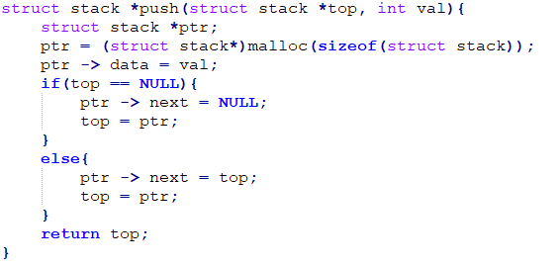
Operations on a linked stack
Push Operation: The push operation is used to insert an element into the stack. The new element is added at the topmost position of the stack.
4
2
6
5 | x
Push 3
TOP
3
4
2
6
5 | x
TOP
1. Allocate memory for the new node and name it as new_node
2. Set new_node->data=val
3. If top=NULL
set new_node->Next=NULL
set top=new_node
else
set new_node->Next=top
set top=new_node
end
Algorithm to insert an element into linked stack

Slide 47
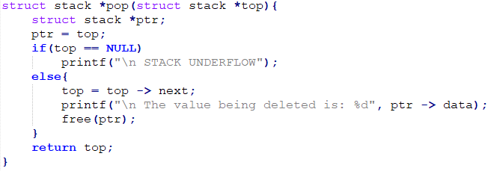
Operations on a linked stack
pop Operation: The pop operation is used to delete the topmost element from a stack. The element is deleted from the topmost position of the stack.
3
4
2
6
5 | x
TOP
pop 3
4
2
6
5 | x
TOP
If TOP=NULL print underflow
End if
2. Set PTR =TOP
3. Set TOP=TOP->NEXT
4. Free PTR
Algorithm to delete an element from linked stack

Slide 48
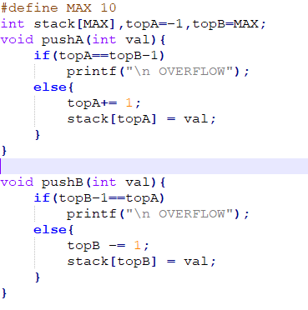
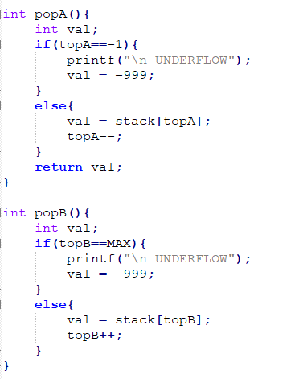
Multiple Stacks
To overcome the frequent overflow while implementing stack using array and issues to know size in advance we can create multiple stack in same array. This idea can be implemented to create n stack in same array.
0
1
2
3
n-3
n-2
n-1
Stack A
Stack B
Push operation
pop operation

